Slide 1


K.RAMAKRISHNAN COLLEGE OF TECHNOLOGY
(AUTONOMOUS), TRICHY.
BLOOD DONATION MANAGEMENT SYSTEM
PRESENTED BY
ENIYAA A
2303811710422040
SUPERVISOR
Mr. M. Saravanan, M.E.,
AP/CSE.

Slide 2
PRESENTATION OVERVIEW
Objective
Project Introduction
Problem Statement
Methodologies (Programming concepts relevant to problem statement)
Architecture of the proposed system
List of Modules
MResults erits
and Discussion
Queries

Slide 3
OBJECTIVE
THE objective of the Blood Donation Management System is to streamline donor registration, track blood inventory, and maintain donor records efficiently. It provides a user-friendly interface for managing operations, ensures data accuracy with validation, and supports scalability for future enhancements. The system aims to enhance blood bank management and promote better organization to facilitate life-saving efforts.

Slide 4
PROJECT INTRODUCTION
Purpose: Develop a software application to streamline blood donation management processes.
Core Functions: Includes donor registration, maintaining records, and tracking blood inventory levels.
Technology Used: Built using Java with a user-friendly GUI developed using Swing and AWT. Goal: Improve efficiency and organization for blood banks and donation centers to support life-saving efforts.

Slide 5
PROBLEM STATEMENT
Inefficient Manual Processes: Many blood banks rely on manual methods for managing donor registrations and inventory, which are time-consuming, prone to errors, and difficult to scale as demands increase. Challenges in Data Management: Maintaining accurate donor records and tracking blood stock levels is often challenging, leading to potential mismatches, resource wastage, or delays during emergencies.
Lack of Scalability: Existing systems often lack features for future expansion, such as centralized databases, integration with online platforms, or advanced analytics, limiting their ability to adapt to evolving needs.

Slide 6
METHODOLOGIES
1.Requirement Analysis: Identify key functionalities like donor registration and inventory tracking to address operational challenges in blood banks. 2. System Design: Create a modular system using Java, Swing, and efficient data structures for scalability and usability. 3. Error Handling: Implement validation and exception handling to ensure data accuracy and system reliability. 4. Testing and Deployment: Test for functionality and performance, resolve issues, and deploy a stable, scalable system.

Slide 7
METHODOLOGIES
5.Future Enhancement Planning: Plan for scalability by designing modules that can be extended with features like centralized databases, AI-based demand prediction, and mobile integration.
6.Development Process: Follow an iterative development approach to implement features, validate user inputs, and ensure seamless integration of components.

Slide 8
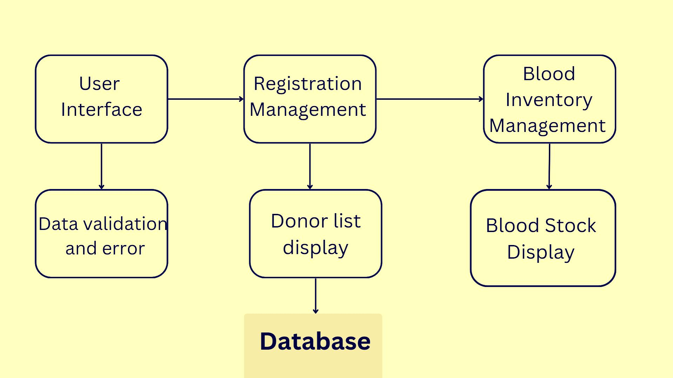
ARCHITECTURE OF THE PROPOSED SYSTEM

Slide 9
LIST OF MODULES
1.User Interface Module :
The user interface is developed using Java Swing and AWT libraries to provide an intuitive and interactive graphical environment. It includes components like text fields, buttons, labels, and lists, which allow users to register donors, view donor history, and manage blood inventory. The layout is managed using GridBagLayout, ensuring a flexible and organized design. This module is critical for facilitating user interactions with the system and ensuring ease of use for non-technical users.
2. Donor Registration Module: This module handles the process of adding new donors to the system. It collects essential information such as name, age, and blood group, validates the data for completeness and correctness, and stores it in an ArrayList. If the input is invalid, it uses exception handling to notify the user with appropriate error messages. This module ensures the accuracy and security of donor information, making it foundational for managing records.

Slide 10
LIST OF MODULES
3. Blood Inventory Management Module: This module maintains the stock levels of different blood groups using a HashMap. Each blood group is mapped to its respective quantity, which can be updated based on donations. It provides real-time data on blood availability, enabling efficient inventory tracking and management. This module ensures that blood banks have accurate information on their stock, aiding in better decision-making during emergencies.
5. Donor History Display Module:
This module retrieves and displays the list of registered donors along with their details, including name, age, and blood group. It uses Java Swing components like Jlist and JTextArea for a clear and organized presentation of donor data. Additionally, it appends blood inventory details for comprehensive reporting. This module helps users easily access donor and inventory information.

Slide 11
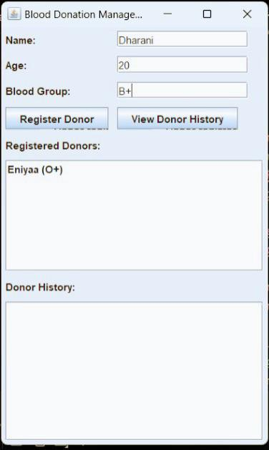
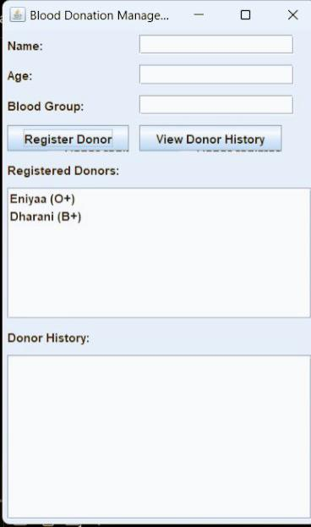
RESULTS AND DISCUSSION

Slide 12
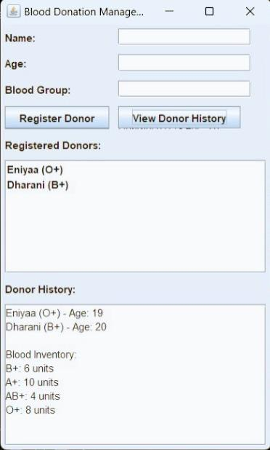
RESULTS AND DISCUSSION

Slide 13
QUERIES ?

